Slide 1
The Alabama Alternate Program
Alabama Alternate Achievement Standards
+
ACAP Alternate
1% Participation
Dr. Elisabeth Davis Susan Goldthwaite
Crystal Richardson Nannette Pence
Maggie Hicks

Slide 2
WHY

Slide 3
USDOE- Letter May 16, 2017
Requirements for the Cap on the Percentage of Student who may be Assessed with an Alternate Assessment Aligned with Alternate Academic Achievement Standards

Slide 4
USDOE LETTER – MAY 16, 2017
General Provisions
SEA must require LEA that assesses more than 1.0% of its assessed students in any subject with an AA-AAAs to submit information to SEA justifying the need to exceed the 1.0 threshold - Exceeding 1% Cap Justification Form
SEA must provide appropriate oversight of EACH LEA that is required to submit such a justification

Slide 5
SEA Waiver Requirements of the 1.0% Cap on Participation on an AA-AAAS
SEA may request the USDOE to waive the cap for that subject for 1 year
Address any disproportionality in % of students in any subgroup taking AA
Must include a plan AND timeline that outlines the following:
  Take additional steps to support and provide oversight to EACH LEA that the state anticipates will exceed the 1.0% threshold
  Include steps to ensure that ONLY students with most significant cognitive disabilities take an AA
  Describe SEA process of monitoring & regularly evaluating each LEA to ensure that the LEA provides sufficient training such that school staff who participate in IEP teams understand and implement guidelines

Slide 6
STUDENT – IEP Profile
STUDENT – IEP Profile
Profile Component | Information
Strengths | Completes all tasks Superb work habits Very conscientious about assigned work Attentive Participates in class discussion Mom states, “… is always eager to learn and is very helpful.”
Parental Concerns | Being able to catch up or get closer to grade level of achievement Being able to function independently as adult
Student Interests/Preferences | Security Guard Works well in small groups and enjoys discussions Likes choices
Assessment Results | AA (reading & math) Level IV Intelligence (IQ) – 83 Adaptive Behavior – 75 Achievement – 58 “..has been able to easily master the Alabama alternate standards.”

Slide 7
Academic Needs | “Has demonstrated the ability to learn at a level that is close to same age peers” Below grade level in written expression & reading comprehension When independently reading a grade level or lower level text, struggles with some of the words and with comprehension Reading level – 4th grade level
Reading Goal | (R.ES.7.1) …will be able to independently read a 5.0 level passage or text and answer comprehension questions including identifying topic sentence …
Developmental & Functional Needs | “..is close to a level consistent with same age peers” Can keep up with belongings and independently cares for self Continues to struggle with behaviors in general education setting Has made progress but continues to take responsibility and doesn’t like to be criticized Argues and makes excuses Has matured and takes redirection in appropriate manner most of the time Able to follow rules of conversational turn taking consistently in small group setting Enjoys interacting with others but continues to have difficulty providing relevant information and staying on topic sometimes
Transportation | Regular Bus

Slide 8
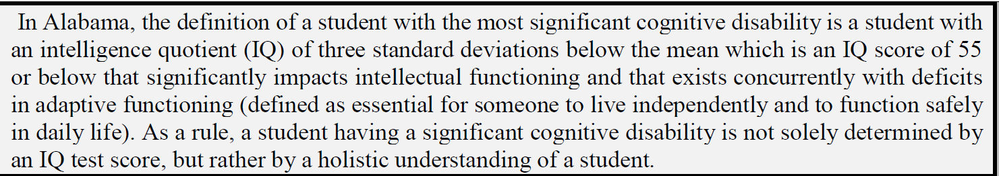
DEFINITION OF A STUDENT WITH A SIGNIFICANT COGNITIVE DISABILITY
3 components of the definition
IQ score of 55 or below
Deficits in adaptive functioning
Understanding of the whole child

Slide 9
CHARACTERISITICS OF A STUDENT WITH THE MOST SIGNIFICANT COGNITIVE DISABILITY
NATIONAL CENTER AND STATE COLLABORATIVE
Disability Categories
Intellectual Disabilities (45.2) | Autism (27.1) | Multiple Disabilities (15.3)
Communication
Pre-Symbolic (9.9) | Symbolic or emerging symbolic (90.1)
Evidence of receptive language (89.9) | No or minimal response to sensory stimuli (11.1%)
Classroom Setting
Self contained classroom (64.4%) | Self-contained with inclusion (15.1%)
Notes:
These are results from the Learner Characteristics Inventory developed by the National Alternate Assessment Center in Kentucky. This assessment was intended to ensure that the test was designed for the intended population and that the intended population was participating in the alternate assessment. So, the National Center and State Collaborative asked 15 states to have teachers complete the inventory of all their students who took the alternate assessment so that a range of characteristics could be described about the learner.
Disability Categories – talk about requirements for eligibility
Communication Pre symbolic – not yet able to communicate using symbols – vocalizations and dietic gestures which is pointing, reaching and showing or purposeful moving to an object. Symbolic communication is a student that speaks or has a vocabulary of signs and pictures to communicate. Recognizes some sights words and numbers
Classroom setting – read slide

Slide 10
CHARACTERISITICS OF A STUDENT WITH THE MOST SIGNIFICANT COGNITIVE DISABILITY
NATIONAL CENTER AND STATE COLLABORATIVE
Reading Skills
reading basic sight words and simple sentences (40.1%)
reading fluently with literal understanding (24.5%);
reading fluently with critical understanding (3.3%)
no observable awareness of text (16%)
Math Skills
counting by rote to 5 (8.6%)
counting with 1:1 correspondence to at least 10 (26.2%)
computing (46.4%) or computing to solve real-life or routine word problems (4.8%)
no observable awareness or use of numbers (14%)
Notes:
This is a list of the levels of reading and math skills exhibited by swscd

Slide 11
DETERMINING A STUDENT’S PARTICIPATION IN THE ALABAMA ALTERNATE ASSESSMENT PROGRAM THROUGH THE IEP PROCESS

Slide 12
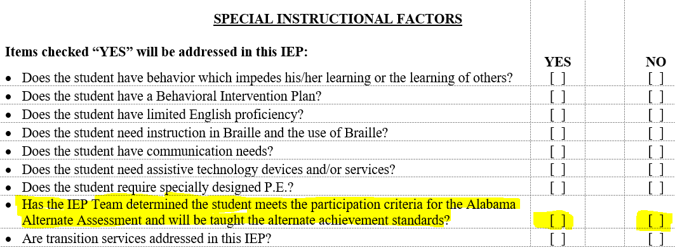

Slide 13
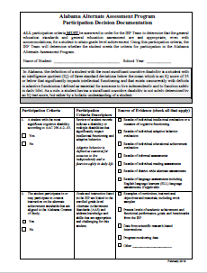
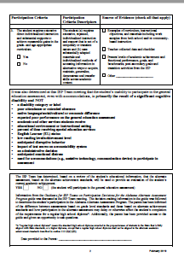
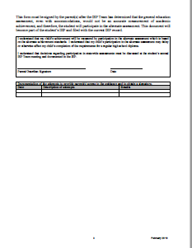
Alabama Alternate Assessment Program Participation Decision Documentation
February 2019
Notes:
When the IEP Team gets to this point, the Team must use the AAAP PDD form to determine if the student is a student with the most significant cognitive disability.

Slide 14
TRAINING FOR THE IEP TEAM MEMBERS
A 4 STEP TRAINING PROCESS
1. REVIEW THE STUDENT CASE STUDY
  2. CREATE A DATA ANALYSIS SNAPSHOT OF THE STUDENT
  3. COMPLETE THE ALABAMA ALTERNATE ASSESSMENT PROGRAM
  PARTICIPATION DECISION DOCUMENTATION FORM
  4. DISCUSS GUIDING QUESTIONS TO REFLECT ON
  THE IEP DECISION FOR ASSESSMENT PARTICIPATION FOR THE STUDENT.

Slide 15
STEP 1- CASE STUDY
CASE STUDY
DISABILITY AREA
LRE
GRADE
AGE
Monique
Intellectual Disabilities
Self- contained
7th
13

Slide 16
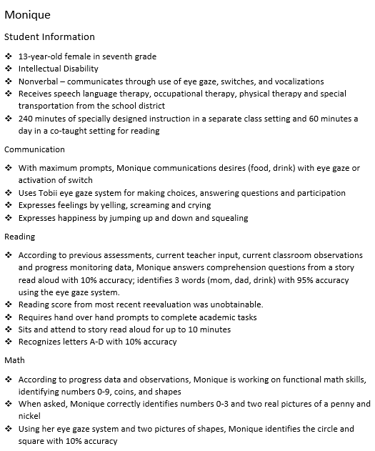
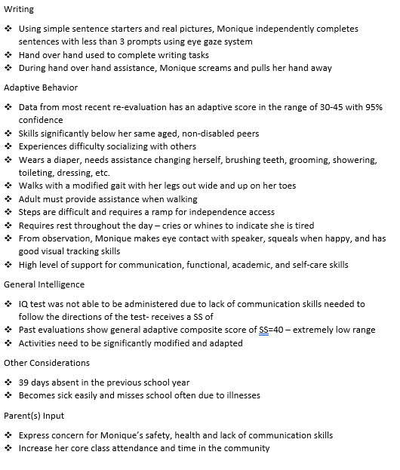
STEP 1 - CASE STUDY

Slide 17
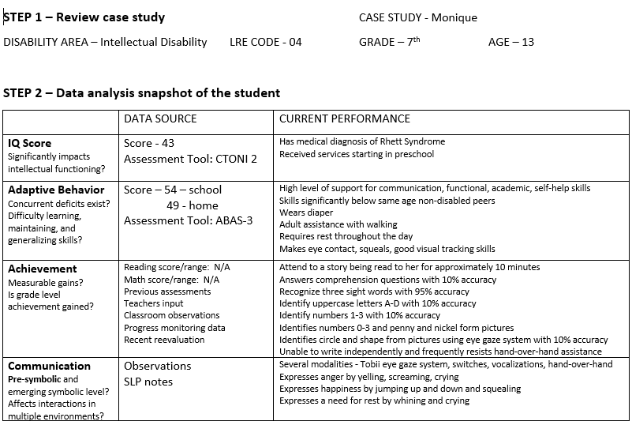
STEP 2 – DATA ANALYSIS SNAPSHOT
Notes:
Read through this analysis

Slide 18
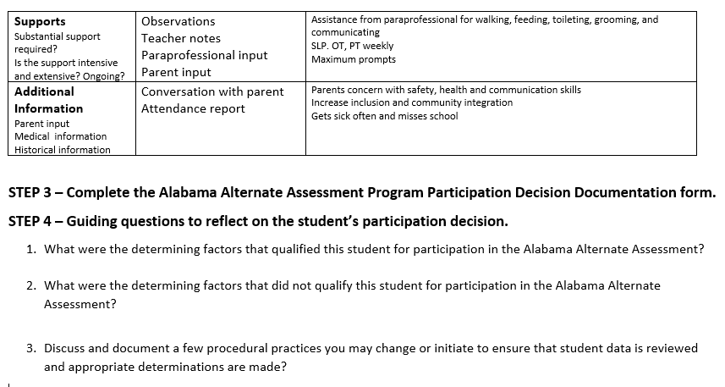
Notes:
So now everyone has a pretty good picture of Monique. All of this information is typically discussed as the IEP Team is completing the profile page for the student. Additional means of collecting this information is to complete an Learner Characteristic Inventory on each student. Remember that was used by the National Center and State Collaborative to categorize characteristics of students with the most significant cognitive disabilities.

Slide 19
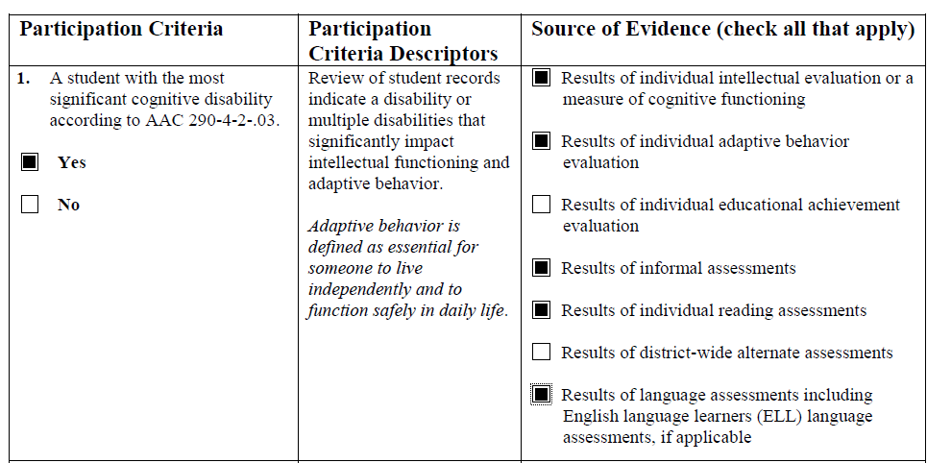
STEP 3 – ALABAMA ALTERNATE ASSESSMENT PPROGRAM PARTICIPATION DECISION DOCUMENTATION FORM
Notes:
Now, using the required State form, the first question has the IEP Team determine based on the student’s IQ and Adaptive functioning if the student meets those two parts of the definition for participation in the alternate assessment. In Monique’s case, the team reviews intellectual evaluations – referring back to your snapshot Monique’s IQ score was a 43 and her adaptive behavior score was a 54 at school and a 49 at home. On the snapshot you will see that information from the current performance of the student in the are of IQ, Adaptive behavior, achievement and communication were used by the team to determine that the student met the first 2 prongs of the definition.

Slide 20
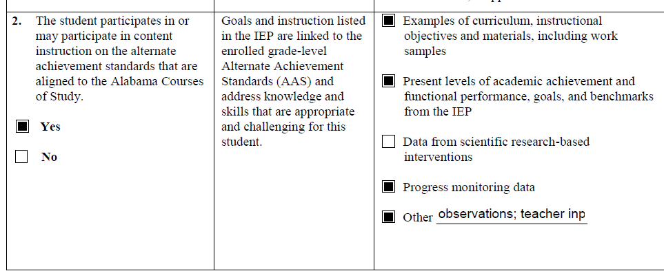
Observations, teacher input, related service providers evaluations and input
Notes:
For the 2nd portion of the criteria, the IEP Team must determine which standards – state content standards or alternate achievement standards – will most appropriately capture the student’s performance. It is important that the IEP Team understand the difference between the assessments based on general education standards and assessments based on alternate achievement standards. For Monique, with her below grade level academic skills , low levels of mastery over year of instruction with high levels of support, and the setting(s) in which she receives instruction, her need for functional instruction both academically and developmentally, and her level of expressive and receptive communication, the IEP Team determined that the alternate standards would be the content the student is expected to learn.

Slide 21
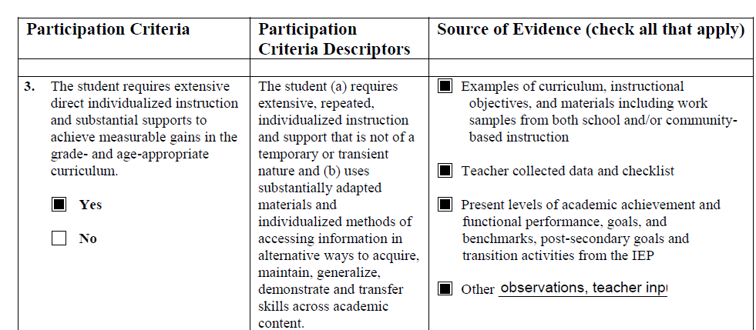
Observations, teacher input, related service providers evaluations and input
Notes:
The 3rd question has the IEP Team examine the supports a student requires to achieve measurable gains. The example Dr. Davis gave about the student that was functioning with his same age peers in reading and math would probably be safe to say that the student was making measurable gains. For a student on the alternate achievement standards, the progress is determined in relation to the student’s expected performance. The Team must build the body of evidence to define a student’s characteristics as a learner. The student’s learning must be pervasive, affecting the student’s learning across content areas and in social and community settings. The IEP Team should discuss what a typical school day looks like for this student – reviewing the level of communication, how much time is spent on learning new material, how much time a teacher spends reteaching and preteaching, and the level and frequency of prompting the student needs. Student also require direct support from adults caretakers with daily living skills. The IEP team must examine how often and with what intensity the student requires direct and individualized instruction. Also, does the student require assistive technology to actively engage and participate in home, community, work and school setting.
In Monique's case, she required full assistance from an adult with academics, physical and daily functional skills. (wears a diaper, need assistance in walking, feeding) Her communication is through vocalizations, signs and gestures. Skills significantly below peers and her learning from year to year is minimal. Supported by 3 related service providers and often misses school due to illness.
The decision for the 3 questions discussed is left to the professional judgement of the IEP Team based on the evidence to support the decision.

Slide 22
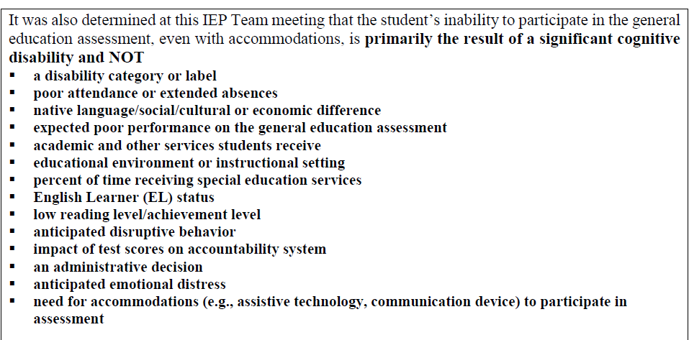
Notes:
An IEP Teams decision can not be made on one of these 14 factors listed

Slide 23
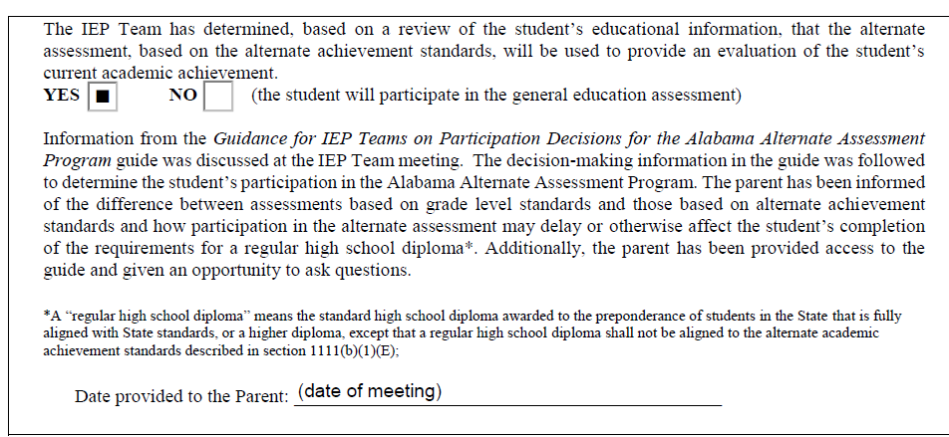
Notes:
The IEP Team will document the decision regarding the student’s participation in the alternate assessment. Also, the team must provide the parent with information from the Guidance for IEP Teams on Participation Decisions for the Alabama Alternate Assessment Program (give a copy or QR Code) and clearly inform the parent(s) of the difference between an assessment based on general education standards and an assessment based on alternate standards and how participation may delay or affect the student’s completion of the requirement for a regular high school diploma. In this section we also give the federal definition of a regular high school diploma. The parent should also have the opportunity to ask questions. The date the parent was given this information will be included her.

Slide 24
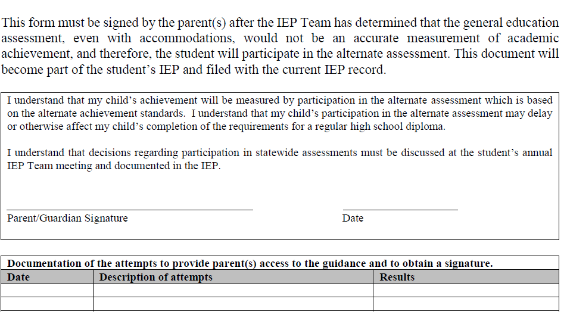
Notes:
This portion of the form is for the parent’s signature. Stating that they understand their child will be participating in the alternate assessment and instruction will be from alternate standards which are aligned to the state content standards. Their signature also signifies that the parent has been informed of that participation in the alternate assessment may delay or affect the completion of a regular high school diploma. Also, the parent understands that this decision is made annually at an IEP Team meeting.
You may also document the attempts to provide the parent with guidance regarding participation in the alternate assessment.,

Slide 25
IDEA AND ESSA
Explanation to IEP Teams. A State (or in the case of a district-wide assessment, an LEA) must—
(1) Provide to IEP teams a clear explanation of the differences between assessments based on grade-level academic achievement standards and those based on alternate academic achievement standards, including any effects of State and local policies on a student's education resulting from taking an alternate assessment aligned with alternate academic achievement standards, such as how participation in such assessments may delay or otherwise affect the student from completing the requirements for a regular high school diploma; and
(2) Not preclude a student with the most significant cognitive disabilities who takes an alternate assessment aligned with alternate academic achievement standards from attempting to complete the requirements for a regular high school diploma.
Notes:
Dr. Davis
For IEP Team members

Slide 26
IDEA AND ESSA
(e) Inform parents. A State (or in the case of a district-wide assessment, an LEA) must ensure that parents of students selected to be assessed using an alternate assessment aligned with alternate academic achievement standards under the State's guidelines in paragraph (c)(1) of this section are informed, consistent with 34 CFR 200.2(e), that their child's achievement will be measured based on alternate academic achievement standards, and of how participation in such assessments may delay or otherwise affect the student from completing the requirements for a regular high school diploma.
Notes:
Dr. Davis
For Parents – there is part of the Alabama Alternate Assessment Program Participation Decision Documentation form that the parent signs stating they understand this.

Slide 27
ACTIVITY
Using Mateo’s educational information,
TURN AND TALK with a partner to complete
STEP 2 – DATA ANALYSIS SNAPSHOT
STEP 3 – ALABAMA ALTERNATE ASSESSMENT PROGRAM PARTICIPATION
DECISION DOCUMENTATION FORM
STEP 4 – GUIDING QUESTIONS

Slide 28
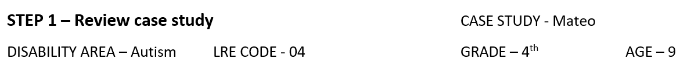

Slide 29
STEP 4 – GUIDING QUESTIONS
What were the determining factors that qualified this student for participation in the Alabama Alternate Assessment Program?
What were the determining factors that did not qualify this student for participation in the Alabama Alternate Assessment Program?
Discuss and document any practices you may change or initiate to ensure that student data is reviewed and appropriate determinations are being made.

Slide 30



ALTERNATE ACHIEVEMENT STANDARDS
Notes:
The alternate achievement standards for math and ela are the areas of concentration for our initial resources.

Slide 31
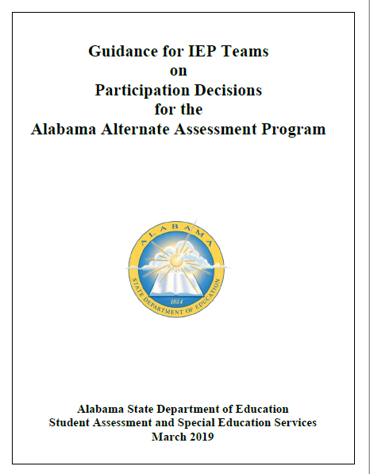

Slide 32

LOCATED ON ALABAMA LEARNING EXCHANGE (ALEX)
Notes:
This is our first resource created by a team of teachers who work diligently to provide instruction based on the alternate achievement standards. This was their idea of a “first” resource. This is formatted into grade bands – k-2, 3-5, 6-8, 9-10, 11-12 for ELA and by grades K-8 and 9-10 Algebra and11-12 geometry and provides a linked resource to every standard with suggested accommodations, modifications and adaptations. All these teachers have multi-grades and multi-skills classroom and are excited about having easily accessible instruction to meet the needs of the students in their classroom.
Where to find this resource – This resource is on ALEX. I want to thank the team at ALEX for assisting us with this and working to include our alternate achievement standards on the website. Now teachers find a standard on ALEX and have instructional material available to be modified. Since some of our teachers are not familiar with ALEX, there is a handout giving directions of how to navigate the site. We look forward to working with many teachers across the state in partnership with the team at ALEX to create additional resources.

Slide 33
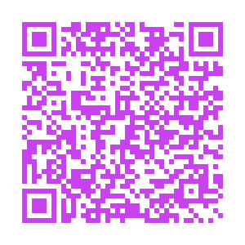
COMING SOON. . . . . .
TEACHING AND LEARNING GUIDES FOR ENGLISH LANGUAGE ARTS AND MATHEMATICS
INSTRUCTIONAL STRATEGIES DOCUMENT
AAS Resource Survey
Notes:
We have teaching and learning guides for LEA and Math that provide instructional guidance for teachers. Included in the guides are achievement elements that identify the essential skills needed to make progress, key vocabulary, a list of learning progressions of the content towards mastery of the standard, and examples of how to apply the alternate standard during instruction.
The Instructional Strategies document will include scaffolds, support and more for each standard. These will probably be ready after the first of the year. (Feb to March)
We look forward to working with many teachers across the state in partnership with the team at ALEX to create additional resources. Your teachers have the opportunity to complete a survey and give us not only their email for sharing of information but to provide us feedback as to what resources would be helpful and share their interest in helping develop resources. Please share this survey or QR code to AAS teachers. This was sent to you in an email from Crystal with MEGA Updates for AAS and Transition. You have a handout with the survey link and the QR code for both surveys. Please share with the AAS teachers. You will hear more about the transition survey tomorrow.

Slide 34

General Courses of Study vs. Alternate Achievement Standards
Which path is BEST for the student???

Slide 35
General Courses of Study
Will the student benefit from being in the general education classroom?
Is the student able to attend classes with minimal assistance?
What types of accommodations can be put in place for the student to take the general assessment?
  Text-to-speech
  Extended time
  Breaks
  Scribe

Slide 36
Alternate Program
Designed for students who need the most individualized instruction
  Conceptual – includes problems with skills in language, reading, writing, mathematics, reasoning, memory, knowledge retention
  Social - refers to issues with empathy, judgment, communication, making and keeping friends, and other social functions
  Practical – focuses on problems with self-care, such as personal hygiene, job duties, personal finance, organization

Slide 37


Slide 38

Alabama Student Assessment Program
Alabama Comprehensive Assessment Program (ACAP)
  ACAP Summative
  ACAP Alternate
  ACCESS for ELLs
  Alternate ACCESS
  NAEP
  Pre ACT
  ACT with Writing
  WorkKeys
Alabama Alternate Program
  Alabama Alternate Achievement Standards
  ACAP Alternate
  Alternate Model Performance Indicators (AMPIs)
  Alternate ACCESS

Slide 39
ACAP Alternate
Grades and Subjects
  2-3- ELA (Language and Reading) and Mathematics
  4-8- ELA (Language, Reading, and Writing) and Mathematics
  4, 6, & 8- Science
  10- Reading, English, Mathematics and Science
  11- Reading, English, Writing, Mathematics and Science
Grade 12- WorkKeys- Optional
  Graphic Literacy, Workplace Documents, and Applied Mathematics
Local Requirements (if there is a required local assessment at either the school or district level)
  Collect evidence for the specific subject and grade OR
  Create a test to assess the specific subject and grade

Slide 40
Alabama Alternate Achievement Standards
  The Alabama Alternate Achievement Standards (AAAS) were developed by committees of Alabama general and special education teachers to guide and direct instruction for students with the most significant cognitive disabilities.
  These standards guide our development of the assessment.

Slide 41
ACAP Alternate
Design/Format
  Administered 1:1 (Test Administrator and Student)
  Paper Test- student booklet
  Web-based-online platform (answer document, Teacher Book)
  Test Administrator Manual (TAM)
Administration
  Scheduling (individual needs)
  Breaks as needed
  Five answer choices (a, b, c, off topic, no response)
  Performance task items
  Manipulatives
  10 Item Rule
Accommodations
  Braille
  Communication device

Slide 42
ACAP Alternate Fall 2019
Regional Trainings- October
Items Specifications
Sample Items Manual
Student Assessment Webpage- ACAP Alternate

Slide 43
English Learner with Significant Cognitive Disabilities
Definition of an English Learner with Significant Cognitive Disabilities
  English learners with the most significant cognitive disabilities are defined as individuals who have one or more disabilities that significantly limit their intellectual functioning and adaptive behavior as documented in their Individual Education Programs, who required extensive direct individualized instruction and substantial supports to achieve measurable gains in the grade and age appropriate curriculum, and who are progressing toward English language proficiency in speaking, reading, writing, and understanding.

Slide 44
English Learner with Significant Cognitive Disabilities
NEW FOR 2019-2020:
  Approval is required for any student who will be participating on the WIDA Alternate ACCESS for ELLs. Guidance for this new procedure will be available in the near future.
  Any Local Education Agency, who administers the WIDA Alternate ACCESS for ELLs assessment to a student who has not received approval, will be responsible for reimbursement to the Alabama State Department of Education.

Slide 45
English Learner with Significant Cognitive Disabilities
Only ELLs with significant cognitive disabilities should take WIDA Alternate ACCESS for ELLs.
Students demonstrating academic difficulties due to learning disabilities, speech-language impairments, and emotional-behavioral disabilities may not necessarily qualify for participation on WIDA Alternate ACCESS for ELLs, and may be better served by WIDA ACCESS for ELLs Online or Paper.
The most appropriate assessment for each English learner student must be listed either in the student’s IEP or 504 plan.
Students with disabilities who can be served with accommodations on the WIDA ACCESS for ELLs Online and Paper assessments should continue to participate in that assessment, NOT WIDA Alternate ACCESS for ELLs.

Slide 46
1% Threshold

Slide 47
Justification
Notification to LEAs that the ALSDE has been determined to be over the 1% participation on the AAA in any subject
Letter to Superintendent
    Exceeding the 1% Cap Justification Form
    Must indicate how all persons who served on an IEP Team were trained on the AAA decision making process and participation guidelines
    Copies of guidance
  Explain WHY your LEA exceeds the 1% threshold
  Assurance
  Superintendent signs the form
  Submitted to ALSDE Student Assessment

Slide 48
USDOE Letter-May 16, 2019
  Show the number and percentage of students in each subgroup who took or will take an alternate assessment.
  Subgroups:
    Male or Female
    Hispanic/Latin, White, Black or African American, American Indian, Asian, Native Hawaiian
    Non-English Learner or English Learner
    Poverty or Non-poverty
    Two or More Races
    Non-Migrant

Slide 49
SEA Waiver Requirements of the 1.0% Cap on Participation on an AA-AAAS
“If a State request to extend a waiver for an additional year, it must demonstrate substantial progress towards achieving each component of the plan and timeline.”

Slide 50
Justification Form
Required for each LEA over the 1% Threshold

Slide 59
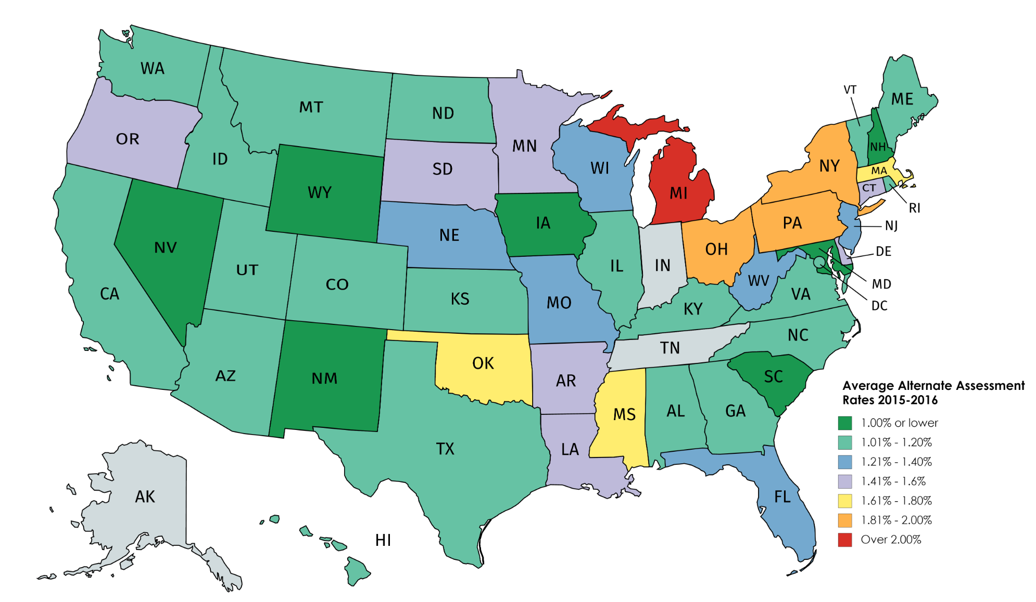

Slide 60
Highest and Lowest AASCD Rates (2015-2016)
Highest State AASCD Rates | Rates
Michigan | 2.32%
Pennsylvania | 1.89%
Ohio | 1.88%
New York | 1.81%
Mississippi | 1.76%
Oklahoma | 1.64%
Massachusetts | 1.64%
South Dakota | 1.52%
Delaware | 1.49%
Minnesota | 1.47%
Lowest State AASCD Rates | Rates
Iowa | 0.73%
New Hampshire | 0.85%
New Mexico | 0.86%
South Carolina | 0.89%
Nevada | 0.92%
Maryland | 0.94%
Wyoming | 0.99%
Montana | 1.01%
North Carolina | 1.01%
California, Colorado, Hawaii, and Washington | 1.02%

Slide 61
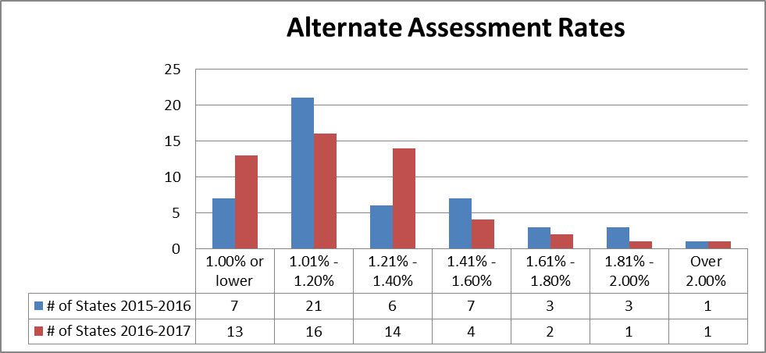

Slide 62
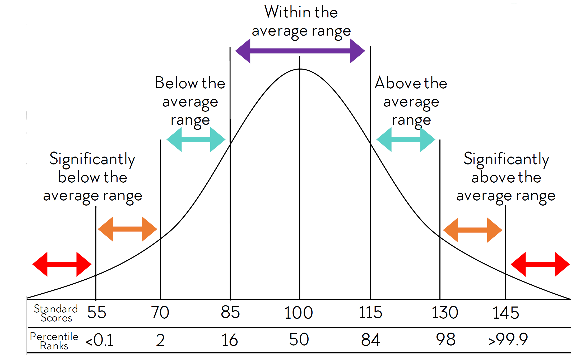
Bell Curve
IQ | Cumulative Percentages
75 | 5.0%
70 | 2.3%
65 | 1.0%
63 | 0.7%
55 | 0.1%

Slide 66

1% Threshold
The total number of students assessed using an alternate assessment may not exceed 1% of the total number of students in the state who are assessed in a subject.

Slide 67
2018-2019 Calculation of Data
Reading
  Total number of students who participated in reading on the Alabama Alternate Assessment in grades 3-8 and 10
  Total number of students who participated in reading on Scantron grades 3-8
  Total number of students who participated in reading on ACT with Writing grade 11
  Total number of students who participated in reading on ACCESS and Alternate ACCESS in grades 3-8 and 10

Slide 68
2018-2019 Calculation of Data
Math
  Total number of students who participated in mathematics on the Alabama Alternate Assessment in grades 3-8 and 10
  Total number of students who participated in mathematics on Scantron grades 3-8
  Total number of students who participated in mathematics on ACT with Writing grade 11

Slide 69
2018-2019 Calculation of Data
Science
  Total number of students who participated in science on the Alabama Alternate Assessment in grades 5, 7 and 10.
  Total number of students who participated in science on Scantron in grades 5 and 7.
  Total number of students who participated in science on ACT with Writing grade 11.

Slide 70
Digging into the Alternate Data
Gender | Grade | Exceptionality | Reading | Achievement | Math | Achievement | Science | Achievement
M | 08 | MD | 514 | 1 | 540 | 3
M | 07 | ID | 574 | 3 | 512 | 2 | 522 | 3
M | 08 | MD | 514 | 1 | 534 | 2
F | 04 | ID | 512 | 2 | 526 | 3
M | 04 | AUT | 533 | 2 | 508 | 2 | 522 | 3
F | 05 | ID | 496 | 2 | 500 | 2 | 488 | 2
F | 06 | SLI | 528 | 3 | 521 | 2
M | 05 | SLD | 547 | 3 | 521 | 2 | 508 | 3
F | 06 | MD | 513 | 2 | 521 | 2
F | 03 | AUT | 400 | 1 | 400 | 1
M | 04 | ID | 600 | 4 | 600 | 4
F | 08 | AUT | 600 | 4 | 600 | 4
M | 07 | OHI | 600 | 4 | 600 | 4 | 600 | 4
M | 07 | SLD | 568 | 3 | 568 | 4 | 600 | 4
M | 03 | ID | 574 | 4 | 531 | 3 | 600 | 4

Slide 71
Digging into the Alternate Data
Alabama Alternate Assessment Data 2018-2019
AIM Portal, DRC Insight Portal, or Data Center
Copy of student raw scores
Export the spreadsheet
Review the data looking for possible red flags
  Disability
  Scores
  Achievement level
  Grade

Slide 72
Monitoring/Support
Special Education Coordinator
System Test Coordinator
Superintendent
Principals
Teachers
Discuss data
Review IEPs
Evaluations/documentation

Slide 73
Training
November 2019
Regional sites
  Principals
  Special Ed Teachers
  Special Education Coordinator
  System Test Coordinator

